Slide 1

Deloitte Pre Hire Training
2017
FOUNDATION TRAINING
Spring Core

Slide 2
Core Spring
Spring JDBC

Slide 3
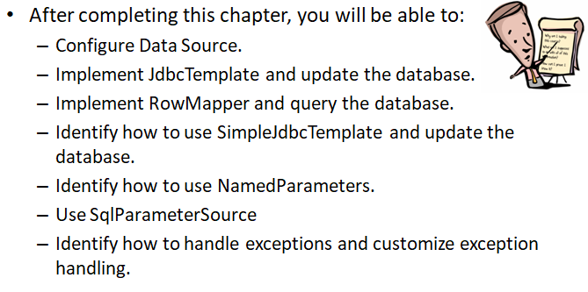
Objectives

Slide 4
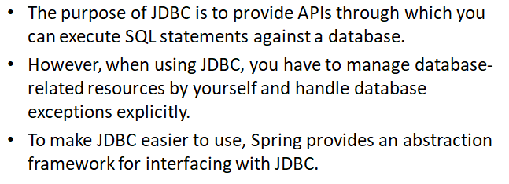
Spring JDBC

Slide 5
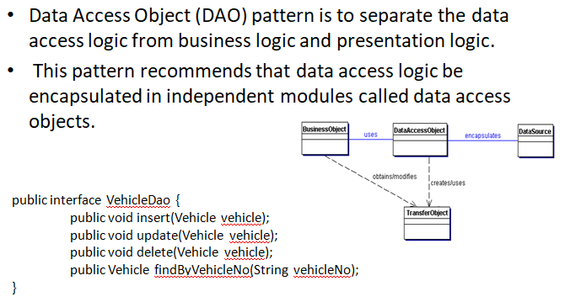
Data Access Object Design Pattern

Slide 6
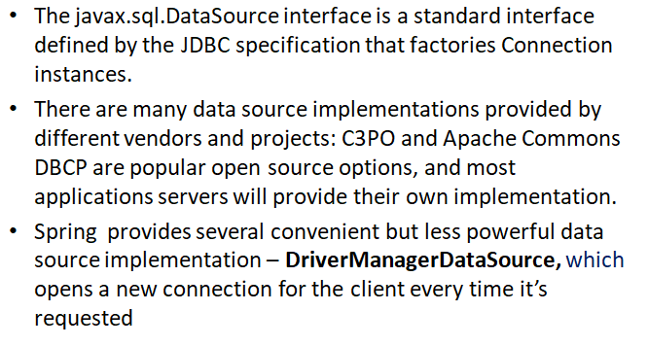
Configuring Data Source in Spring

Slide 7
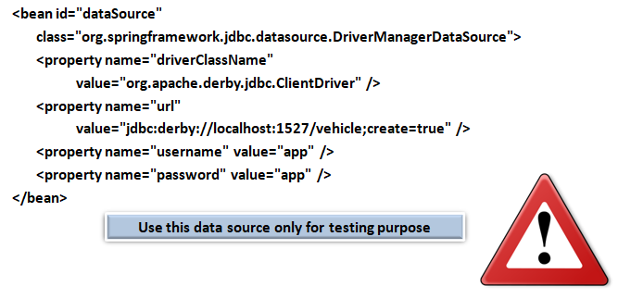
Configuring Data Source in Spring

Slide 8
Demo
Demo on how to configure DataSource in XML file

Slide 9
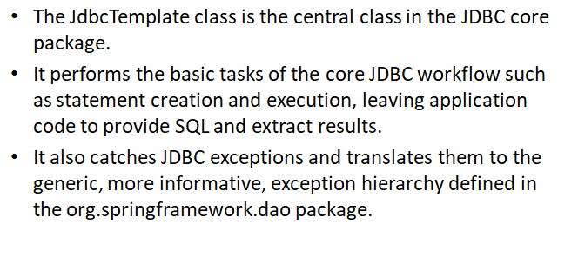
Using JdbcTemplate

Slide 10
Demo
Write a simple code and explain spring JdbcTemplate

Slide 11
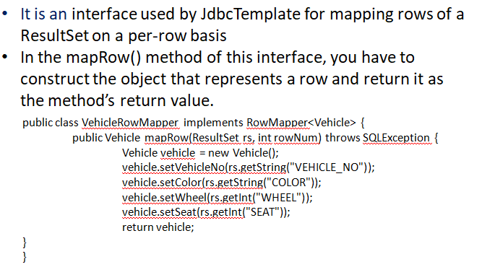
RowMapper<T>

Slide 12
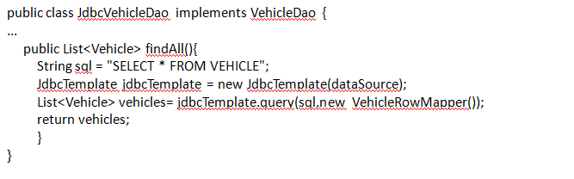
RowMapper<T>

Slide 13
Demo
Code example on how to use RowMapper

Slide 14
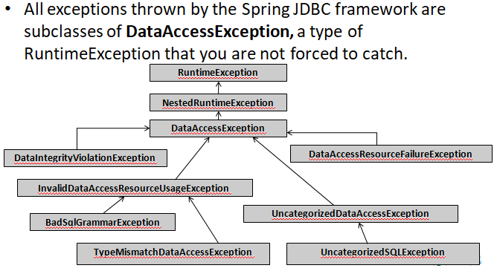
Handling Exceptions

Slide 15
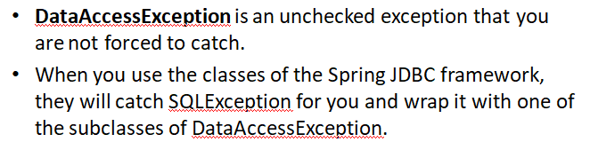
DataAccessException

Slide 16
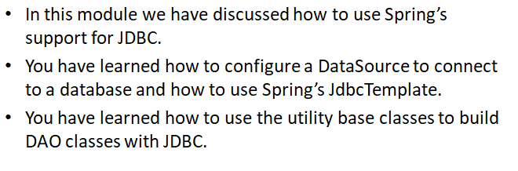
Summary

